Slide 1
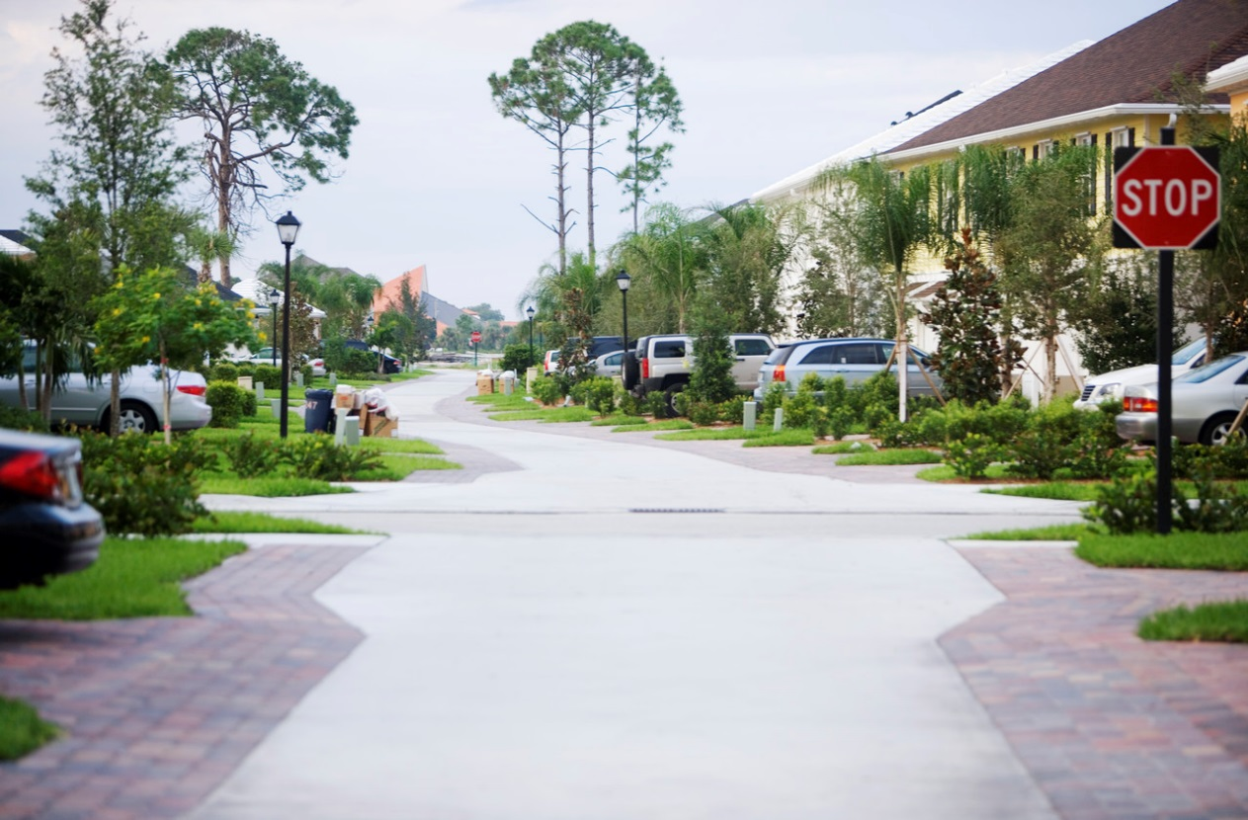
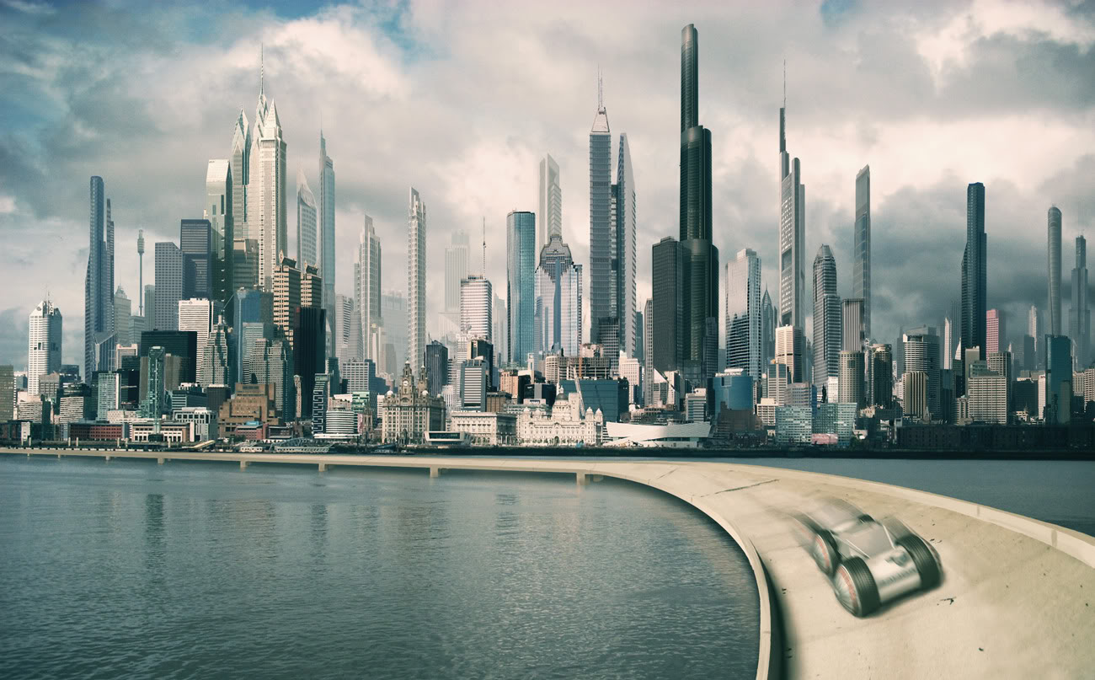
How do people use land?
By Yanellie Magdaleno

Slide 2
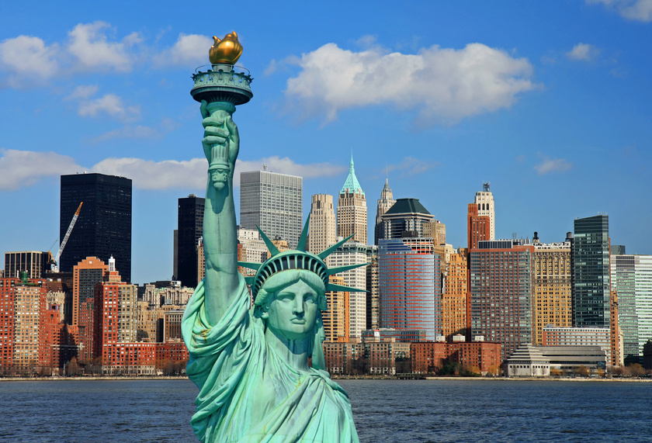
URBAN AREA
An URBAN area is a location characterized by high human population density and vast human built features.
URBAN areas may be cities , towns conurbations.

Slide 3
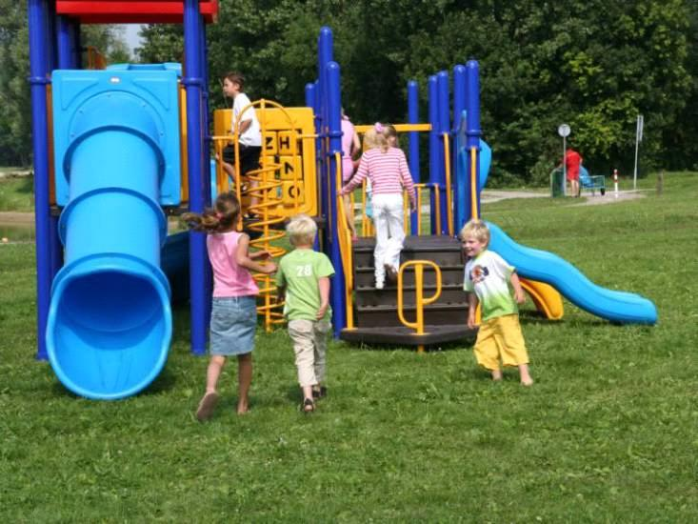
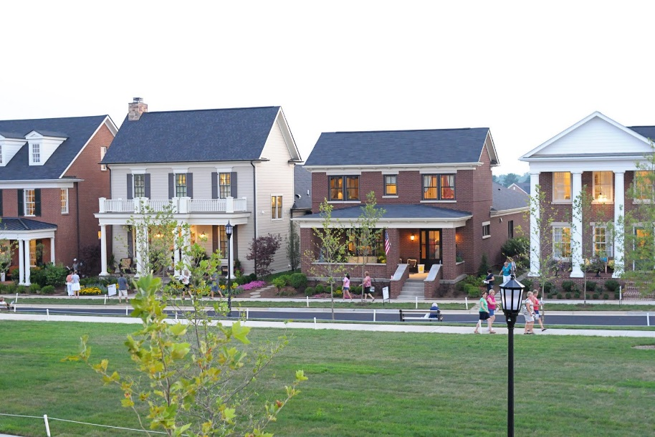
SUBURBAN AREA
What does SUBURBAN mean?
SUBURBAN means a community that is located in areas that are outside of the city or a large town.
Another name for SUBURBAN is SUBERB .

Slide 4
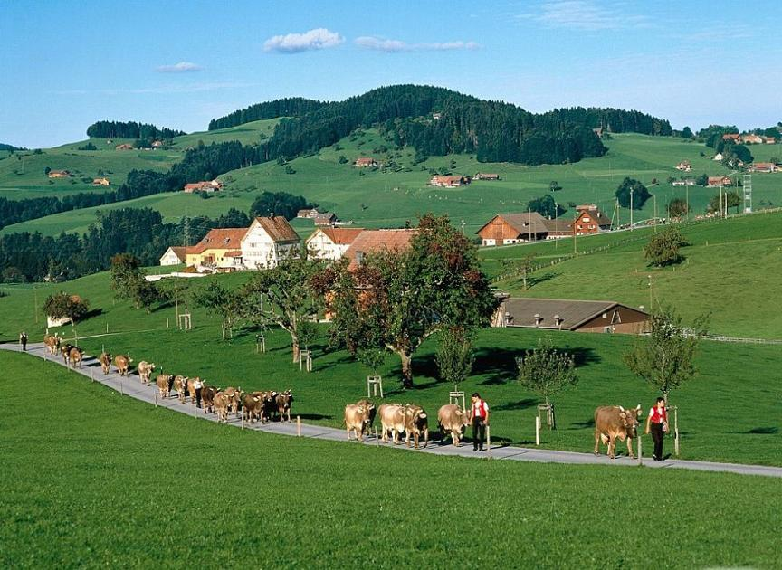
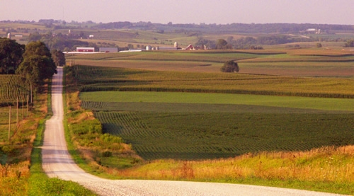
RURAL AREA
Rural communities typically have smaller populations and an agricultural setting, but some areas contain forests.
A rural area comprises a group of inhabitants who live a rustic or country lifestyle.

Slide 5
WHERE I GOT MY INFORMATION ?
bibliography
2nd slide National Geographic Education
3rd slide Brain Pop Jr.
4th slide Ask.com
THANK YOU!!

