Slide 1
Proper Keyboarding Techniques
Adapted from presentation by: Nadine Bunnell, Keyboarding Specialist Used with permission. nbunnell@usoe.k12.ut.us
Utah State Office of Education, Curriculum & Instruction, Applied Technology Education www.usoe.k12.ut.us/ate/keyboarding/key.htm

Slide 2
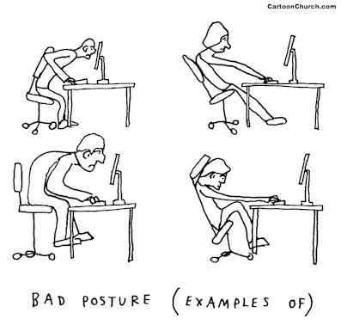
While most kids and adults can learn to hunt and peck on their own, real typing speed depends on PROPER TECHNIQUE.
Michael J. Himowitz, Baltimore Sun
People who used to find “hunt and peck” keyboarding sufficient realize that it doesn’t make much sense to have a computer with lightning speed if the information inputted into the machine trickles in like molasses in January. Sandberg-Diment, 1984

Slide 3
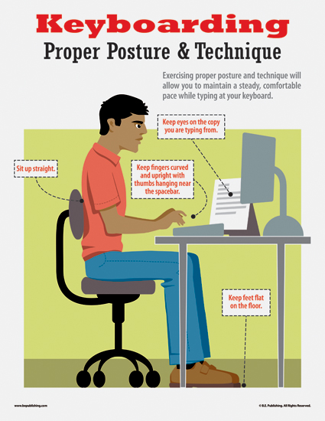
Keyboarding Proper Posture & Technique
Eyes on monitor
Fingers curved on Home Row position
Wrists flat
Back straight
Feet flat on floor

Slide 4
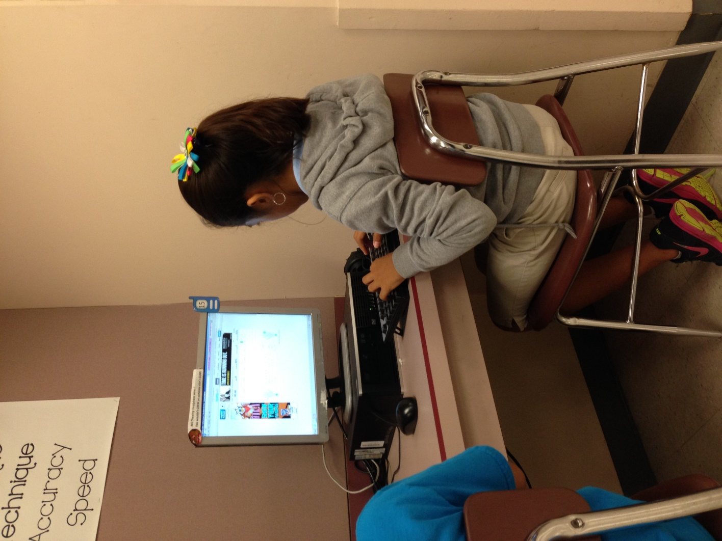
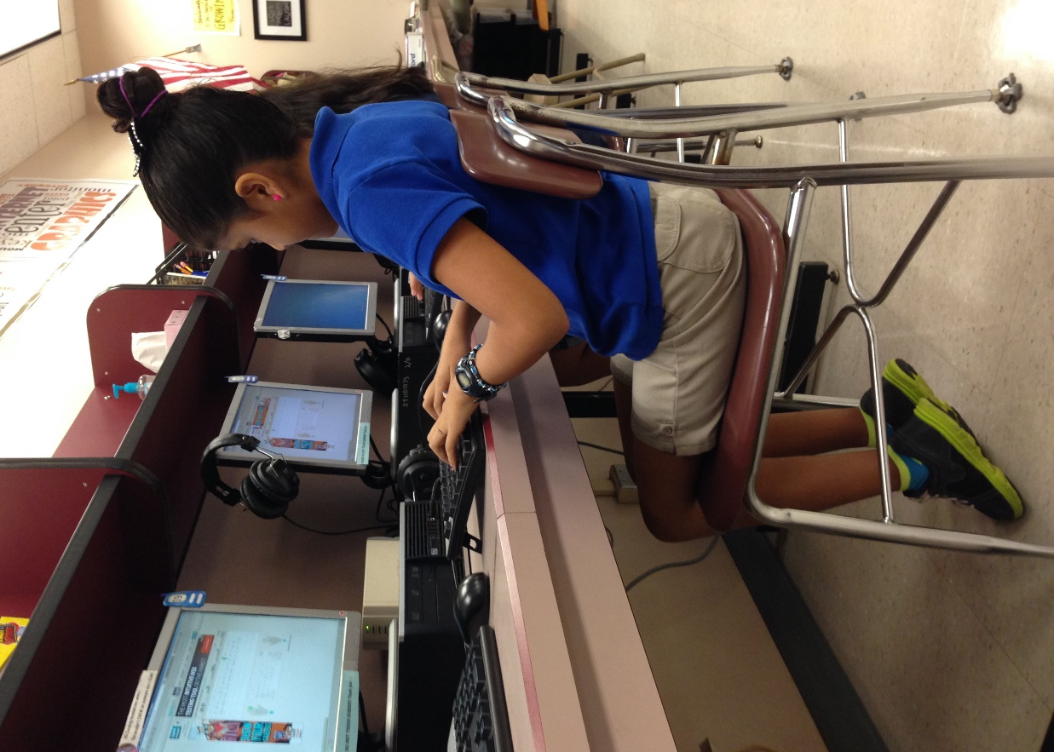
Posture & Position at the Keyboard
Eyes level with the text on the monitor

Slide 5
Posture & Position
at the Keyboard
Fingers curved

Slide 6
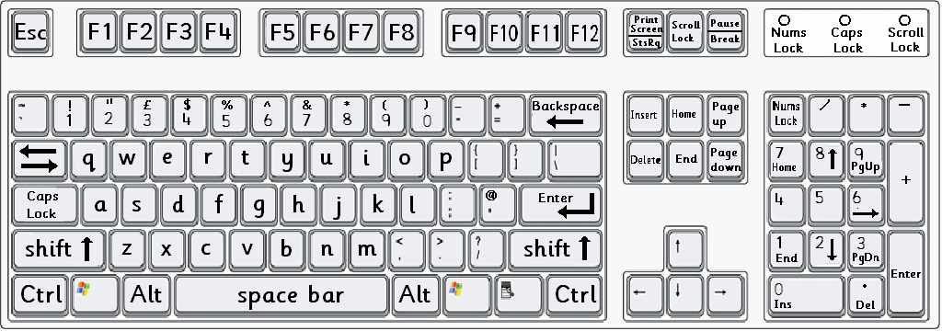
The Computer Keyboard
Learning the names of the different keys

Slide 7
Click on the different coloured sections to find out the names of the keys.
Escape Key
Typewriter Keys
Other Keys
Numeric Keypad
Function Keys
Alt Keys
Space Bar
Cursor
Keys
Enter Keys
Windows Keys
Control Keys

Slide 8
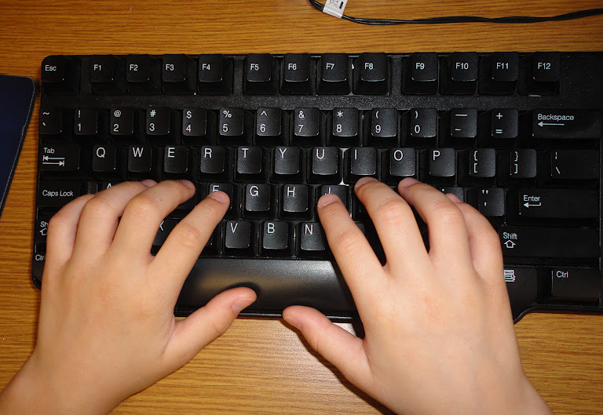
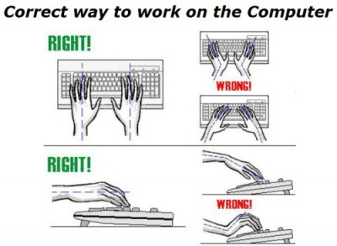
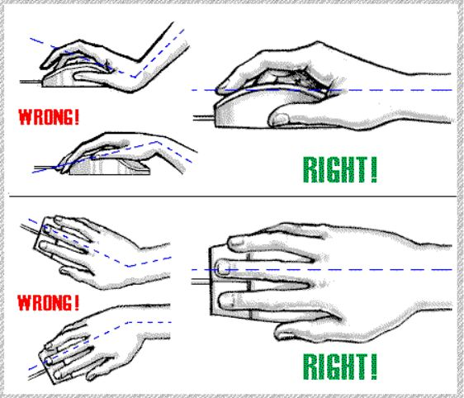
Posture & Position at the Keyboard & Mouse
Wrists off the keyboard

Slide 9
How Important are Proper Keyboard Techniques?
Not only does proper keyboarding technique help develop skill but it also helps prevent the development of RSI - repetitive stress injury, more commonly known as ...
carpal tunnel.

Slide 10
How Important are Proper Keyboard Techniques?
Techniques
Techniques
Techniques
Techniques
Techniques
Techniques
Techniques
Techniques
Speed
Accuracy

Slide 11
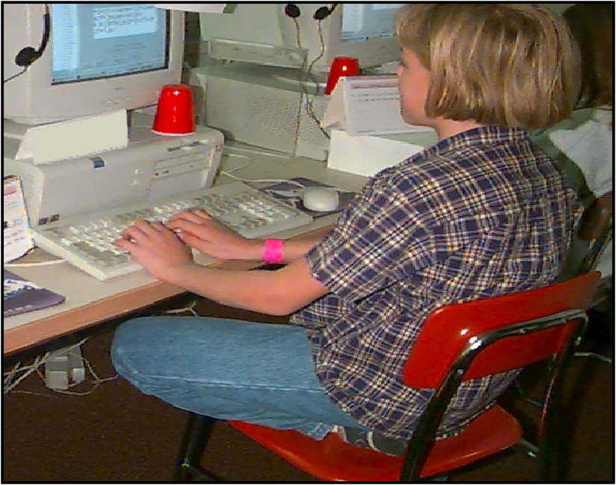
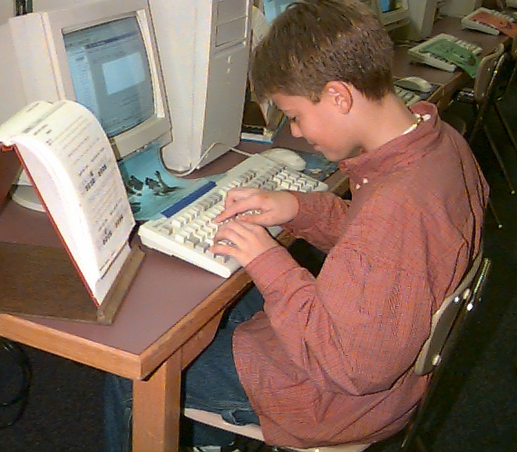
Posture & Position at the Keyboard
What Techniques Do You See?

Slide 12
Adapted from presentation by: Nadine Bunnell, Keyboarding Specialist Used with permission. nbunnell@usoe.k12.ut.us
Utah State Office of Education, Curriculum & Instruction, Applied Technology Education www.usoe.k12.ut.us/ate/keyboarding/key.htm

