Slide 1
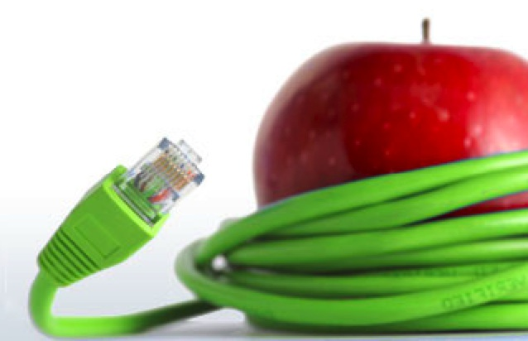
Parts of a Computer
Notes:
I plan to use this presentation for an introduction at the start of the year. Maybe even create a “word wall” with the cards.

Slide 2
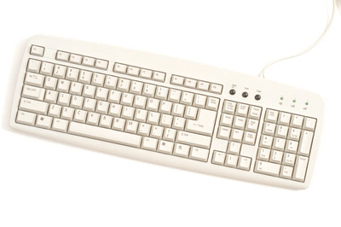
Keyboard: The input device that you use to type letters, numbers, and symbols into a computer.

Slide 3
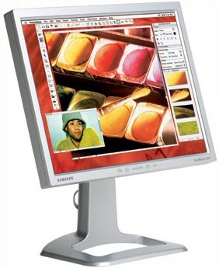
Monitor: Shows you information on a screen.

Slide 4
Mouse: A pointing device you use to input data.

Slide 5
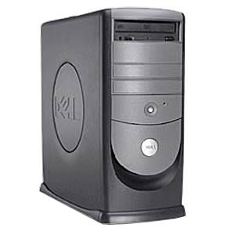
System Unit: Contains hardware inside it that processes data.

Slide 6
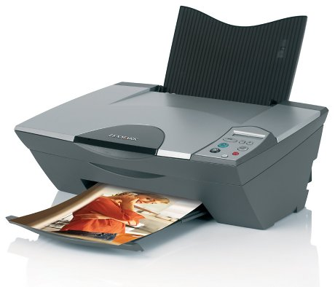
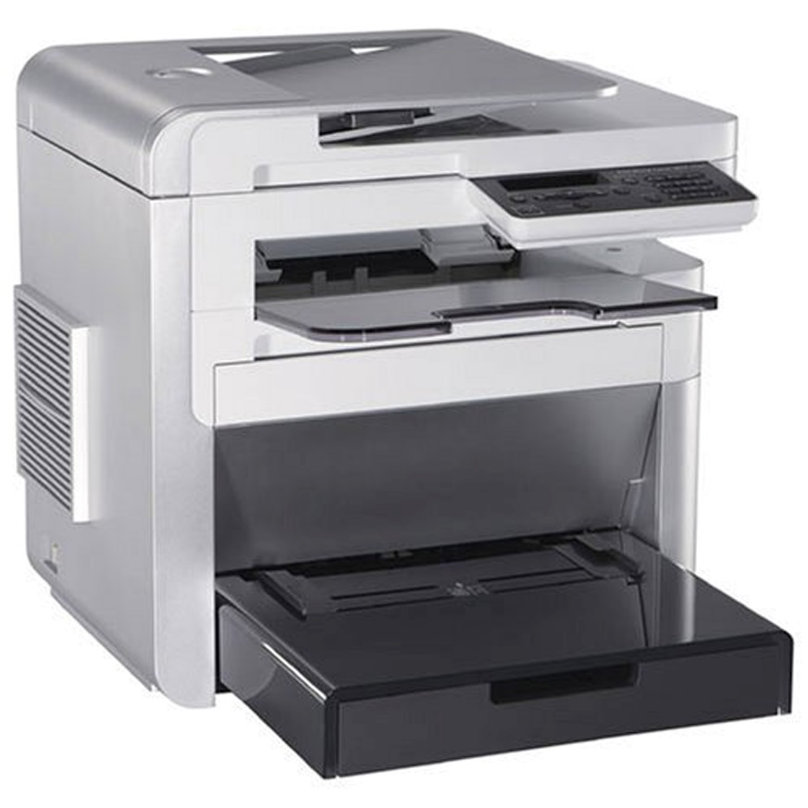
InkJet Printer
Laser Printer
Printer: Prints information onto paper.
Laser Printer: Fastest type of printer.
Inkjet Printer: Sprays ink through nozzles to create images onto paper.

Slide 7
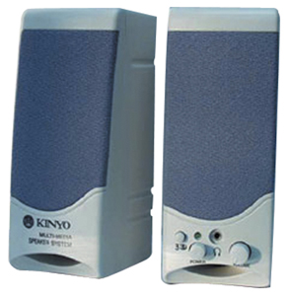
Speakers: Output devices for words, music, or sound.

Slide 8
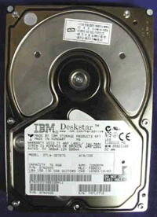
Hard Disk: The storage device that is inside the system unit of your computer that stores the software and data.

Slide 9
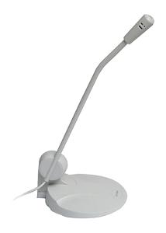
Microphone: Input device that inputs sound and converts it into data for the computer.

Slide 10
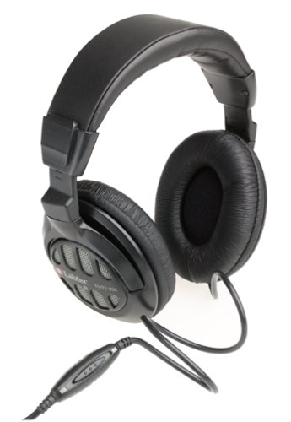
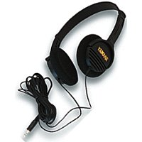
Headphones: Output speakers that rest on your head and cover your ears so that only you can hear the sound.

Slide 11
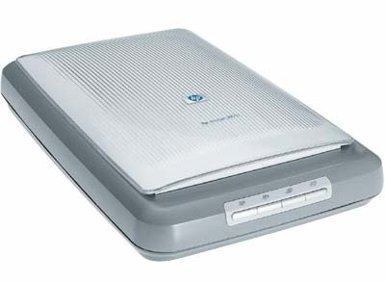
Scanner: Input device that converts information on a page as input for the computer.

Slide 12
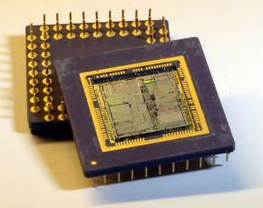
CPU – Central Processor: The chip that stores the data and programs while the computer is turned on.

Slide 13
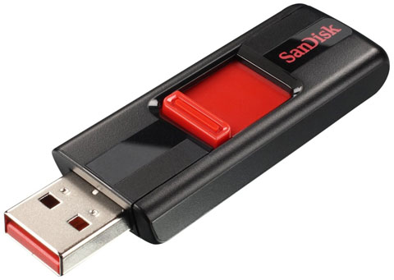
A Flash Drive is a small self-powered drive that connects to a computer directly through a USB port.

Slide 14
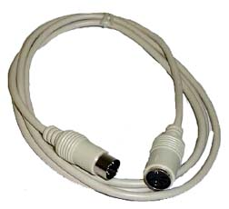
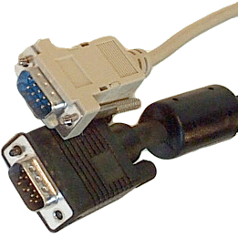
Cables: Wires that connect devices to computers.

Slide 15
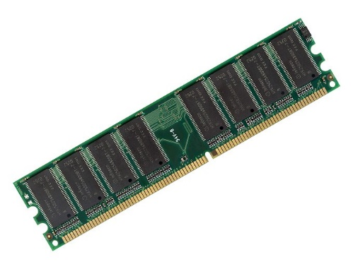
RAM (Random Access Memory) Memory chips that store the data and programs while the computer is turned on.

Slide 16
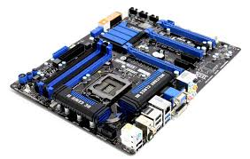
Motherboard (systems board): The main circuit board in the system unit. Contains the memory and processor chips.

Slide 17
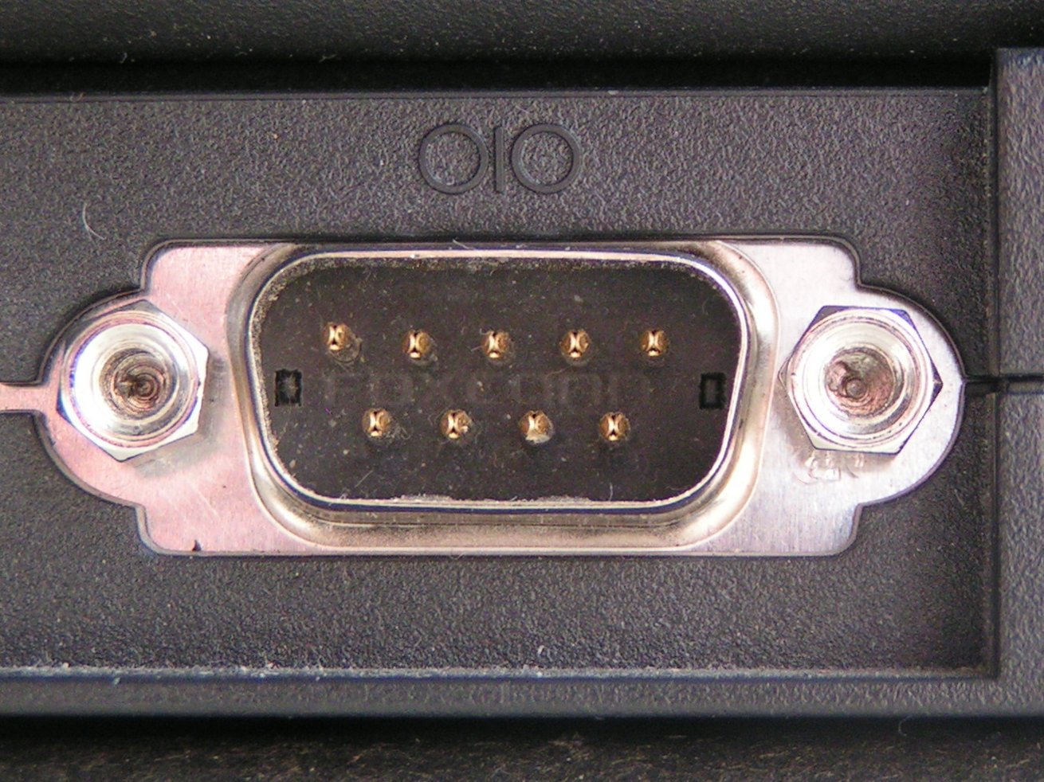
Serial Port: Located on the system unit. What you plug the connector into so data can be transmitted from devices such as a joy stick or a modem.

Slide 18
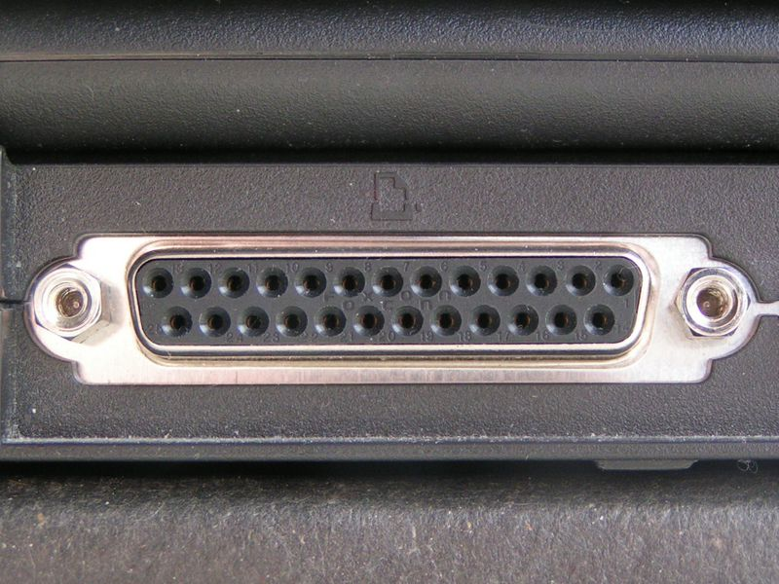
Parallel Port: Located on the system unit. What you plug the connector into so data can be transmitted to and from printers.

Slide 19
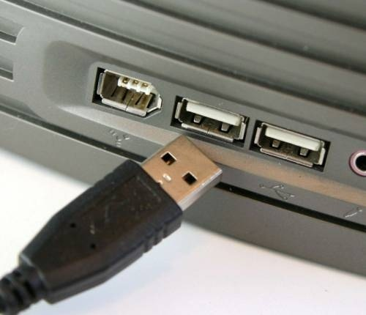
USB Port: Located on the system unit. What you plug the connector into so data can be transmitted from an input device such as a digital camera to the computer.

