Slide 1
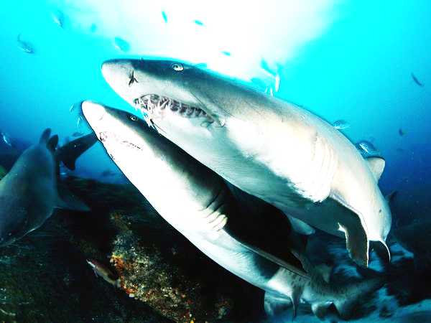
The Amazing Sharks
By Charles C.
Notes:
Sharks eat other sharks some sharks eat turtles. Sharks are fish.

Slide 2
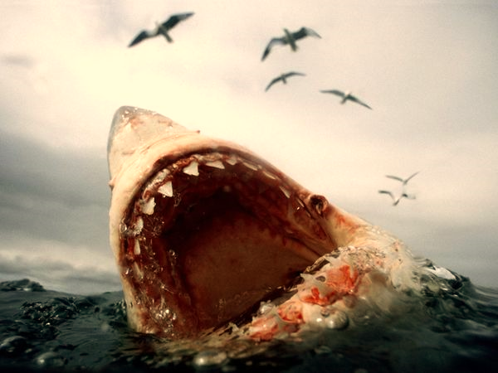
What does a Shark Look Like?
Sharks have sharp teeth to rip apart meat.
They have a good sent of smell a great white shark can smell a drop of blood from a mile away.

Slide 3
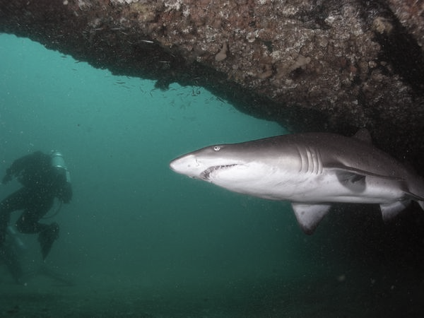
Where Does it Live?
Sharks live in all oceans. Some sharks such as the bull shark live in rivers near by people.

Slide 4
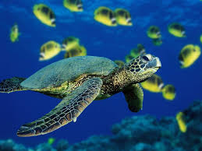
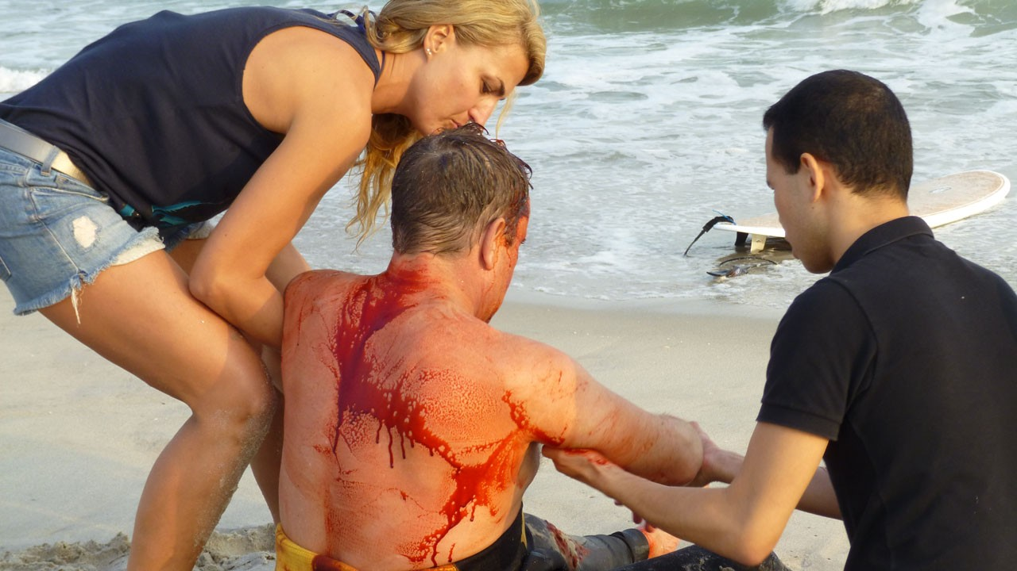
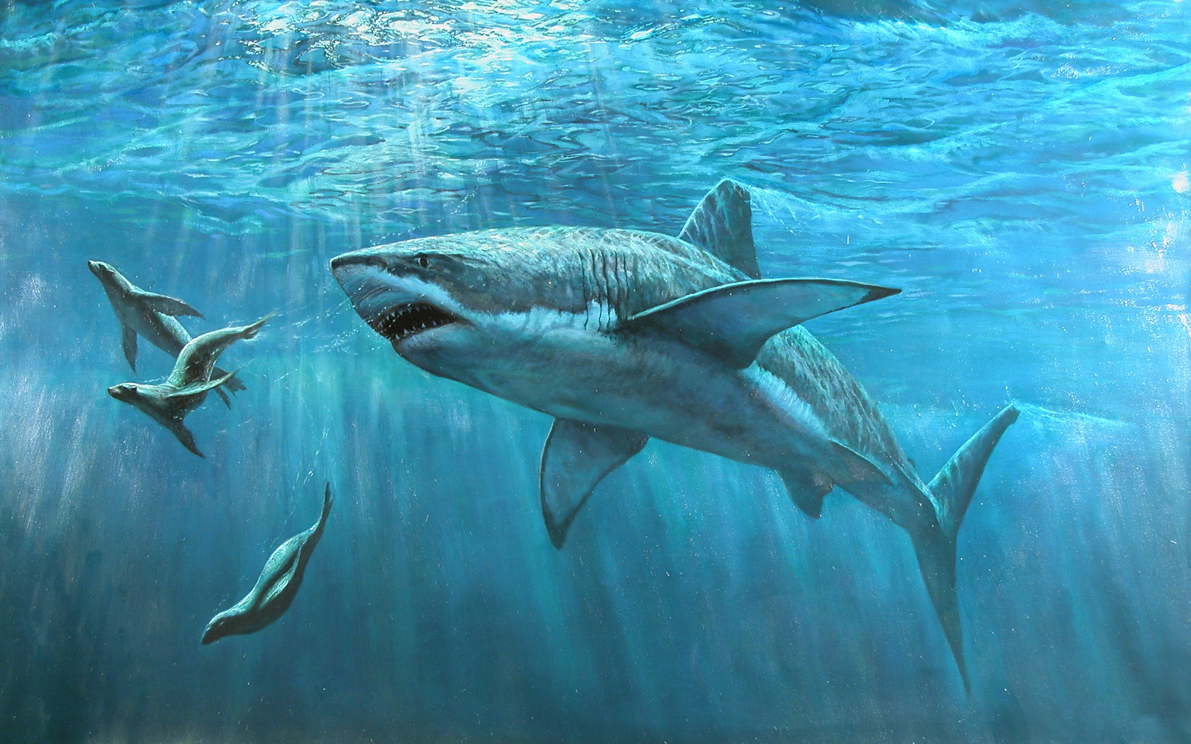
What Does a Shark Eat?
Sharks eat seals, turtles and even other sharks.
Sharks some times kill people. Its because when a surfer splashes the board looks like the body of a seal. The arms look like the flippers.

Slide 5
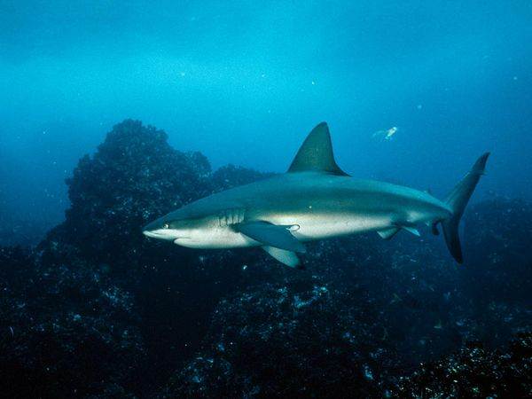
The End

